Slide 1

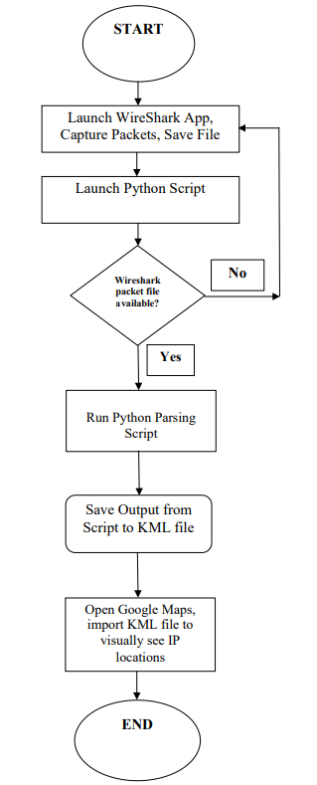
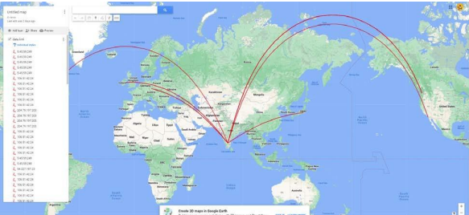
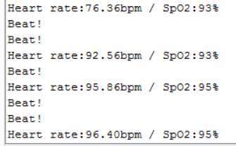
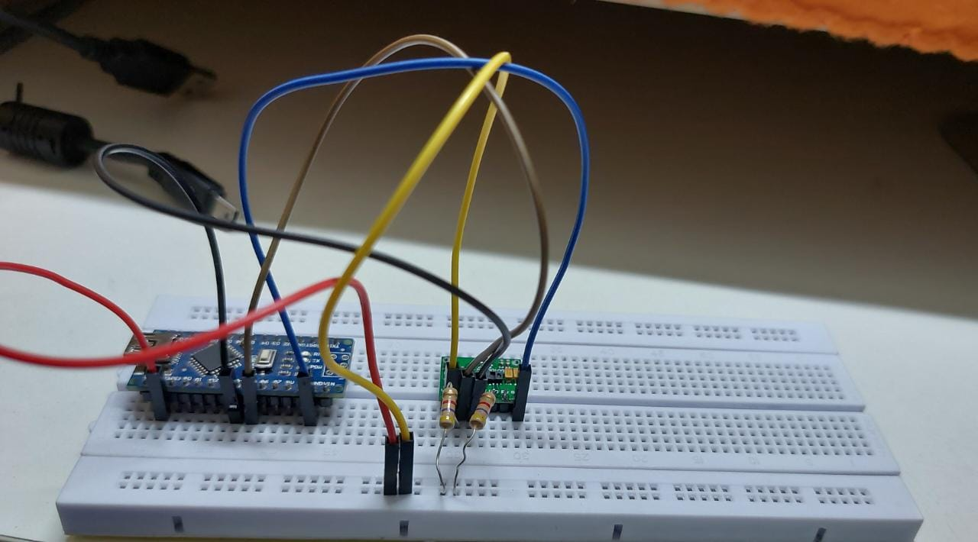
EXPERIENTIAL LEARNING PROJECT TITLE : “Python Cybersecurity— Network Tracking using Wireshark and Google Maps”
Student Name: Vedanth,Shravan,Aviral
Faculty Name : Dr.Mohana (Department of Computer Science and Engineering)
R.V. College of Engineering, Bangalore-59
22EM106 – Introduction to Cyber Security
1) INTRODUCTION
4) OBJECTIVES
7) APPLICATIONS
10) REFERENCES
Cyber Security experts employ different tactics to secure computer systems and networks. we are demonstrating one of the basic activities that involve tracking of sites visited by a user. This is achieved by looking at the network packets that are sent over the internet to various locations based on the IP address of source and destination.
The objective of our simulation is to observe the destination of the data packets sent by the user. If the data packets reaches any destination not specified by the user, appropriate measures can be taken place
Troubleshooting
Capacity Planning
Performance Optimization
Quality of Service (QoS)
Kovtsur Maxim, Potemkin Pavel,RESEARCH OF WIRELESS NETWORK TRAFFIC ANALYSIS
Himanshu Gandhi,Vinay Ribeiro, PACKET BATCHING IN NETWORK TRAFFIC ANALYSIS
Vanya Ivanova, Tasho Tashev, Ivo Draganov,DETECTION OF IOT BASED DDoS ATTACK BY NETWORK TRAFFIC ANALYSIS
2) TOOLS AND TECHNOLOGIES USED IN PROJECT
5) METHODOLOGY
.
Hardware Components:
Windows 11 Desktop
Minimum 8gb RAM
Software Components:
Wire shark
Google Maps
Python script
The project uses an application called ‘WireShark’ which helps captures the network packets that are sent out from the origin system. These packets are then stored in a special file. A custom application, written in Python, then opens this saved packet file, does a reverse lookup of the IP address and converts to geo-location (latitudes/longitudes). The output from the Python program is then provided as input to Google Maps, which then pictorially shows the actual origin and destination locations of the network packets.
8) CONCLUSION
TEAM MEMBERS BIOGRAPHY
In the modern world where internet connectivity has become ubiquitous, it is very much essential for a user to be cautious on securing his/her computer system through all cyber secure means to prevent data snooping/data theft. The user should always use certified copies of software, should NOT install any unknown/unsigned/unlicensed software, should have malware protection software installed and should show utmost caution in not visiting unwanted phishing sites on the internet that might install malware/virus software on the host system.
Shravan V (RVCE22BEC179)
Vedanth Sriram (RVCE22BEC094)
Aviral Jain (RVCE22BEC037)
3) PROBLEM STATEMENT
6) RESULTS OBTAINED
9) FLOWCHART
Due to very large bandwidth provided by ISP, people generally allow a lot of traffic through without even analyzing or ensuring to whom the data is being received by Without the user’s knowledge, a third-party user might be capturing the data packets being transmitted, makes a duplicate copy and sends it to the destination. By knowing the frequent destinations with which user interacts with, they can extract these data and use it for malicious purposes.
This pictorial representation is based on the sites visited via the browser. The operating system on the host (Windows) also constantly communicates with servers outside the country. Hence it can be seen that some of the packets of information have be sent to US (Washington) as well.
Connections are made and Arduino IDE software is launched
Finger is brought close to MAX30100 sensor once the code is uploaded
The respective values are displayed on the Serial monitor

